Slide 1
Today’s Goals
Considering the interplay between magma pressure and host rock stress, when will an inflating magma system rupture?
We will examine a specific limited case, and so will not code for the balance of stresses in all directions.
Full treatment of the topic is contained in Grosfils (2007)
Using typical test cases, can we use observed displacement magnitudes to constrain what sorts of pressures, assuming an elastic system, best characterize magma reservoir rupture?
Notes:
Ask students to brainstorm as many as they can think of

Slide 2
Magma Reservoir Loading/Stresses/Failure
CREST
σ_{z} = ρ_{r}gz
P_{m} = ρ_{r}gz + OP
σ_{n} = P_{m} – σ_{z} = OP
Induced tangential stress is –σ_{n}/2
Resisting stress is σ_{z} = ρ_{r}gz
MIDDLE
σ_{z} = ρ_{r}g(z+R)
P_{m} = ρ_{r}gz + OP + ρ_{m}gR
σ_{n} = P_{m} – σ_{z} = OP
Induced tangential stress is –OP/2
Resisting stress is σ_{z} = ρ_{r}g(z+R)
BOTTOM
σ_{z} = ρ_{r}g(z+2R)
P_{m} = ρ_{r}gz + OP + ρ_{m}g2R
σ_{n} = P_{m} – σ_{z} = OP
Induced tangential stress is –OP/2
Resisting stress is σ_{z} = ρ_{r}g(z+2R)
σ_{z}
CREST
z >> R
σ_{z}
P_{m}
R
MIDDLE
P_{m}
σ_{z}
P_{m}
σ_{z}
σ_{z}
BOTTOM
Failure Occurs at the Crest
σ_{z}
Notes:
This is what exists in the host…

Slide 3
Two Formulations: Equivalent?
σ_{z}
σ_{z} = ρ_{r}gz
P_{m} = ρ_{r}gz + OP
σ_{n} = P_{m} – σ_{z} = OP
CREST
z >> R
Widely
Used
Model
σ_{z}
OP
OP
P_{m}
R
MIDDLE
R
R
Subsurface
conditions
OP
OP
P_{m}
σ_{z}
P_{m}
OP
OP
σ_{z}
σ_{z}
BOTTOM
Failure occurs at the crest
Failure equally likely anywhere
σ_{z}
Notes:
Multi-step here
Failure conditions not the same
Pressure balance reduces neatly to OP (implies densities identical)
Does not resolve what happens to the wall-parallel components, so not yet equivalent

Slide 4
To Eliminate Wall-Parallel Host Stress…
CREST
z >> R
σ_{z}
If intrusion is present P_{m} works directly against wall-parallel host rock stress…
…but problem is then one of crack propagation, not initiation.
OP
R
MIDDLE
OP
- or -
If pore pressure in the host rock is lithostatic then the rock would exist in a state of imminent tensile failure…
OP
σ_{z}
σ_{z}
BOTTOM
Notes:
Intrusion – different problem, not what folks have been claiming to model at all
Pore pressure creates a low effective stress, nullifies normal stress magnitudes… this would seem to be the way to do it, and as I’ll show later is consistent with experimental results

Slide 5
How to test between these???
One first order way to test this is by using uplift data, in combination with what it takes to rupture the system, to assess each of these elastic models
Before doing so in COMSOL, a few quick reminders…

Slide 6
Failure due to Inflation
Plexus of Cracks
Reservoir with “notch”
Ellipsoidal
Notches are intuitive, though we argued
can’t subsist for long (drivers are toward
ellipsoid). BUT: if they exist, means
very low pressures to drive intrusion, of
order <10 MPa. What uplift will this yield?
Notes:
-- Answer to Q is <1 cm

Slide 7
Failure due to Inflation
Plexus of Cracks
Reservoir with “notch”
Ellipsoidal
Ellipsoids seem simplistic, and as shown
earlier stresses must be high to overcome
resisting stress and rupture (unless reservoirs
are all at brink of failure due to lithostatic
pore pressure). What uplift is produced?

Slide 8
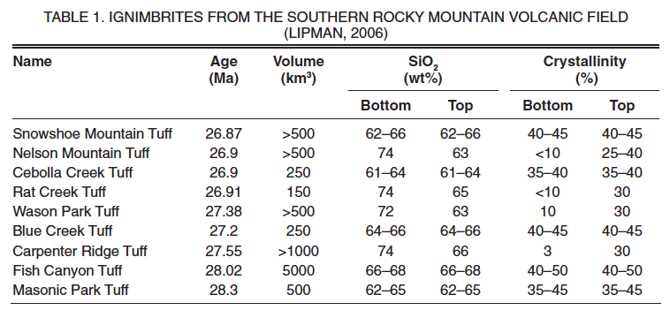
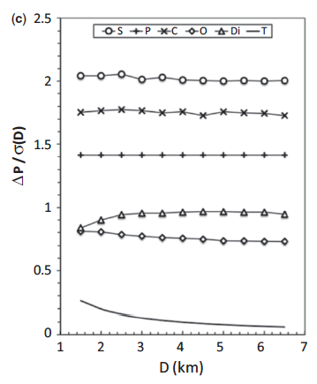
Reminder: high OP can be generated
Inflation
Magma infusion from external source
Bubble nucleation (Tait et al., 1989)
Deflation
Magma escape from reservoir
intrusion/eruption
Volatile loss from reservoir
sphere
mildly oblate
Notes:
N is Henry’s Law exponent, 0.7 for basalt and 0.5 for felsic
Plot shows felsic, assumes simplest case (most important factor) due to cooling-induced volatile exsolution.
Contribution from CO2 is minor, considers here only H2O
Crystallinity is high, OP from crystallization is high
Collapse down to a scaled variant, 2x OP requires ~40-45% crystallinity, oblate require <30%
Don’t bring up, but be ready to discuss: Viscoelastic stress relief is a question, so relative time frame for bubble nucleation vs viscous stress is key to this

Slide 9
Time to test!
Test Approach – see Day 3 Case Study PDF
Use COMSOL model from last time as starting point
How much OP is needed to cause rupture?
At OP needed for rupture, how much surface uplift has occurred?
Consider observed uplift magnitudes:
To generate signatures of 10’s of cm or more, a typical value…
…what OP values are required?
…what are the volcanological conditions/implications?
To generate signatures that are very low, millimeter scale…
…what OP values are required
…what are the volcanological conditions/implications?
Underscores need to consider uplift and rupture conditions jointly!

Slide 10
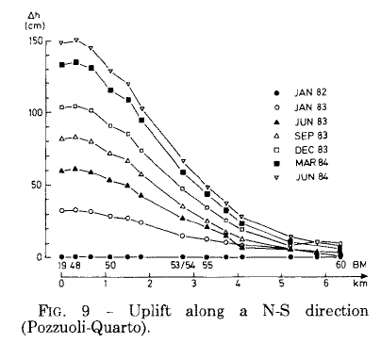
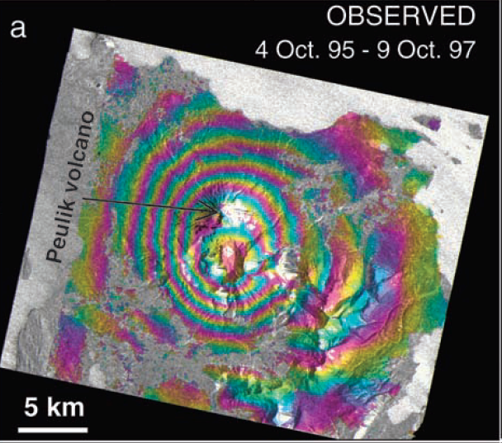
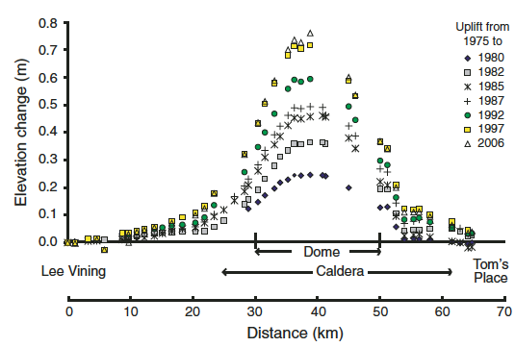
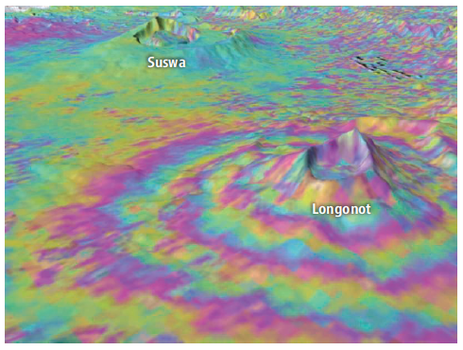
Uplift Examples
Both InSAR inteferograms are 2.83 cm/fringe
-- Campi Flegrei caldera (Berrino et al., 1984)
-- Aleutian stratocone (Lu et al., 2002)
-- Long Valley caldera (Tizzani et al., 2009)
-- Kenyan stratocone (Sparks et al., 2012)
Notes:
Print, provide…

Slide 11
Next Time
Magma System Longevity
Obtaining first order thermal insights

